Slide 1
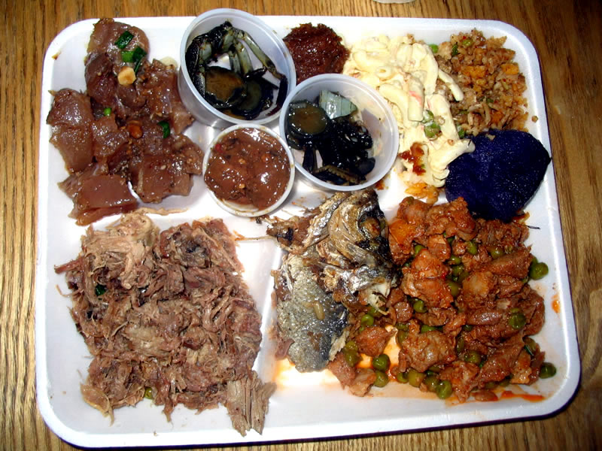
Importance of
Digestion

Slide 2
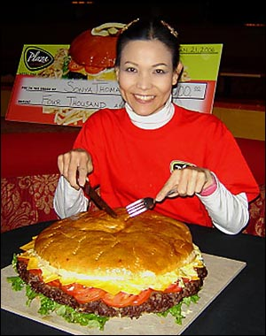
Importance of Digestion
Since we are heterotrophic we need to consume our food to get nutrients. Our food gets broken down in the gastrointestinal tract, absorbed and transported by the circulatory system.
Digestion is the breakdown of large materials into smaller components used by our bodies.

Slide 3
Four Components of Digestion
ingestion – the taking in of nutrients
digestion – the breakdown of complex organic molecules into smaller components by enzymes
absorption – the transport of digested nutrients to the tissues of the body
egestion – the removal of waste food materials from the body

Slide 4
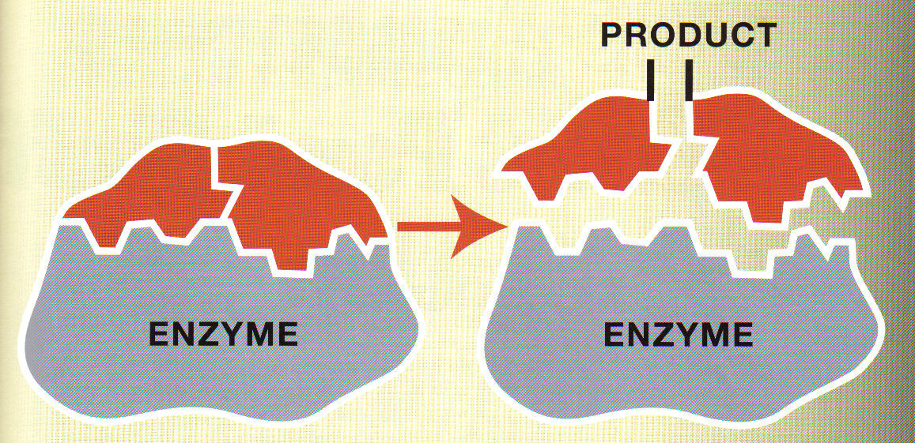
Enzymes
Protein molecules that help speed up important chemical reactions in the body

Slide 5
Digestive enzymes
Enzyme function is regulated by two factors, temperature and pH. All enzymes have their optimal ranges for each.
Most human enzyme work best at 37 ºC and drops when over heated, because the enzyme will denature.

Slide 6
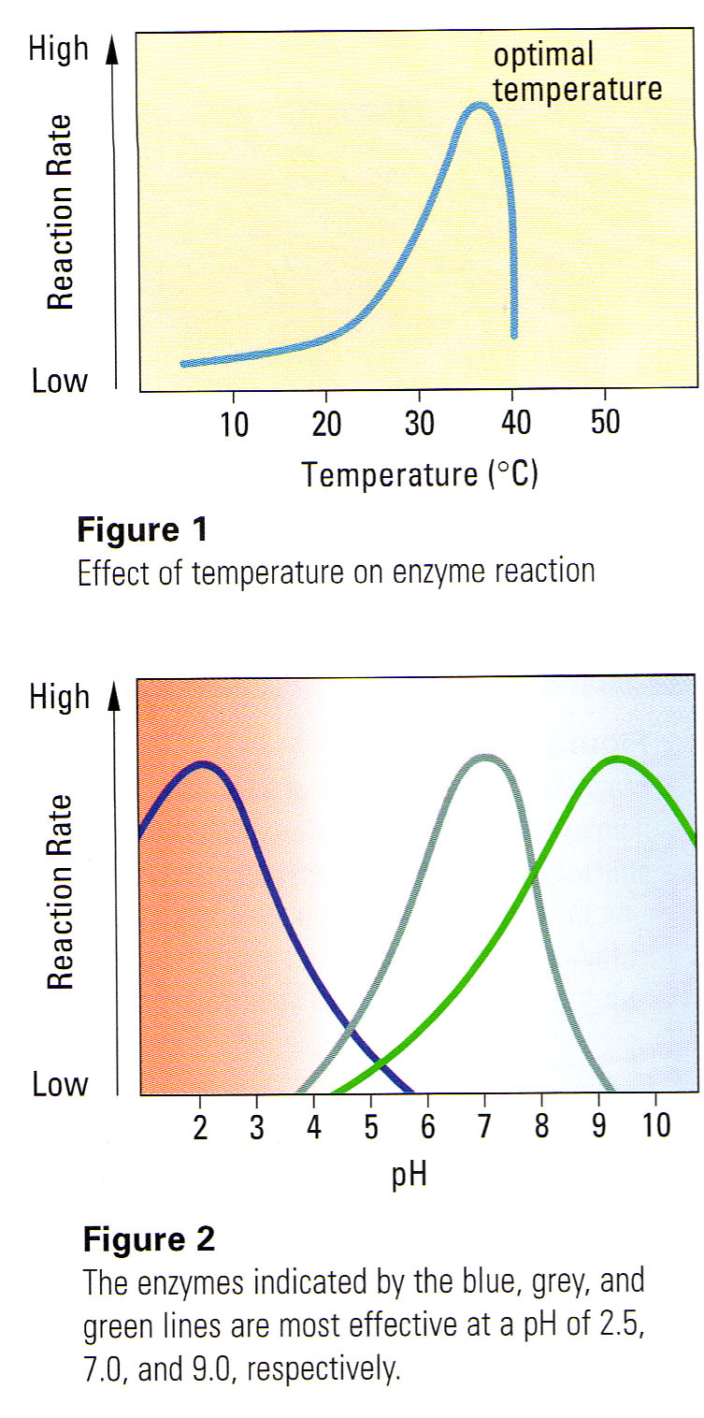
Digestive enzymes
The diagram outlines three enzymes and their pH ranges for function. Pepsin is the first (blue), amylase is second (grey) and trypsin is in green. This may also tell you where each is found in the digestive tract.

Slide 7
Mouth
Mechanical ingestion of food (teeth)
Incisors are used for cutting
Canines are used for tearing
Premolars are used for grinding
Molars are used for crushing food.
Breaking into smaller pieces increases surface area
Organism’s diet can be assessed based on type of dentition present.

Slide 8
Mouth
Chemical digestion of starch begins (saliva)
The saliva:
contains amylase enzymes that initiates carbohydrate breakdown (starch into simple sugars)
Lubricates the food passage;
Dissolves food particles;
Activates the taste buds.
Bolus of food and saliva is created and then swallowed (voluntary response)

Slide 9
Esophagus
A hollow muscular tube.
The bolus of food moves through the esophagus by peristalsis.
Peristalsis allows food to be moved involuntarily. Involuntary movement continues until egestion occurs.
Epiglottis prevents food from "going down the wrong way" (into trachea or windpipe)

Slide 10
Peristalsis Animation
http://www.youtube.com/watch?v=rJS-Kh5wCQU

Slide 11
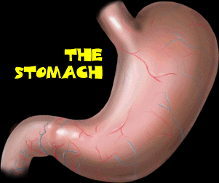

Slide 12
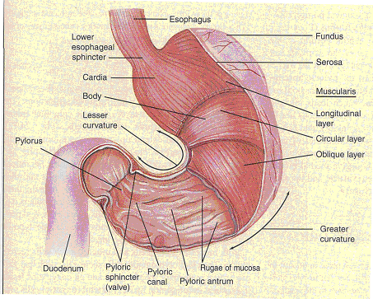
The Stomach and Digestion
After moving down the esophagus the bolus, food ball, goes through the esophageal sphincter and enters the stomach.

Slide 13
Stomach
The stomach is the site of mechanical and chemical digestion, food storage and initial protein digestion.
A muscular, J-shaped organ
The walls are folded like an accordion allowing the stomach to expand
Muscle fibres (rugae) contract and relax to mechanically churn food pieces to form a thick liquid called chyme

Slide 14
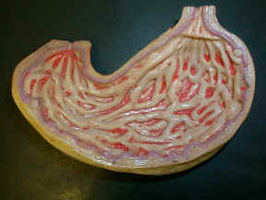
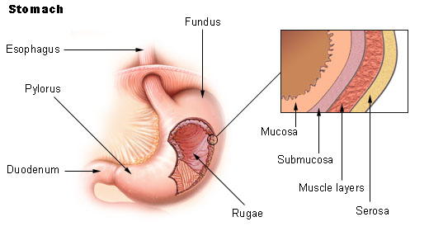
The rugae are the folds inside the stomach.

Slide 15
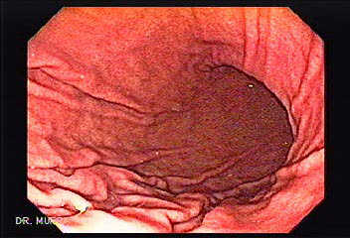
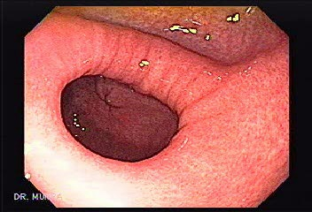
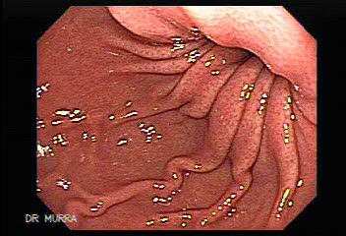
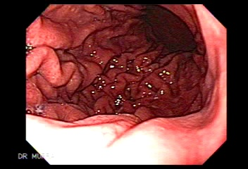

Slide 16
Stomach
Lined with gastric glands that secrete gastric juice:
Hydrochloric acid
Salts
Enzymes
Water
Mucus
Mucus protects the stomach lining from extreme acidic environment (pH of 1-3)

Slide 17
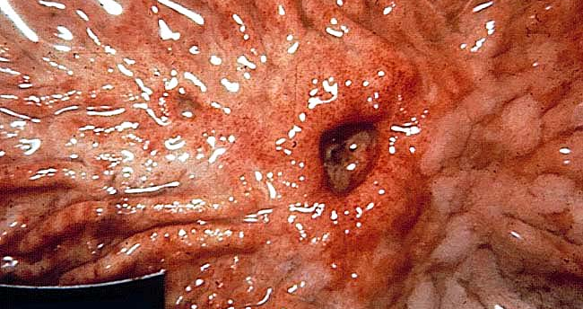
The Stomach and Digestion
The stomach is protected by an alkaline layer of mucus
The destruction of the cell membrane leads to an ulcer, which is a sore or break in the stomach lining.

Slide 18
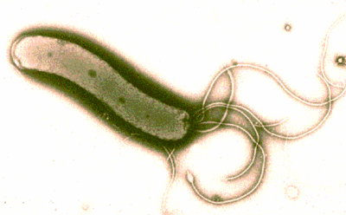
The Stomach and Digestion
Ulcers have been linked to a bacterium named Helicobactor pylori.
Although diet, stress and other factors may still play a part. This was not too long ago that doctors figured out that this bacterium has a role in ulcer creation. It prevents the production of mucus.
It is a extremophile (lives in extreme conditions), as a result often need powerful antibiotics.

Slide 19
Stomach
Pepsinogens are converted to pepsin which breaks long chains of proteins into shorter chains called polypeptides.
When food is processed (2-5 hours), the pyloric sphincter opens and the stomach pushes chyme into the first part of the small intestine

Slide 20
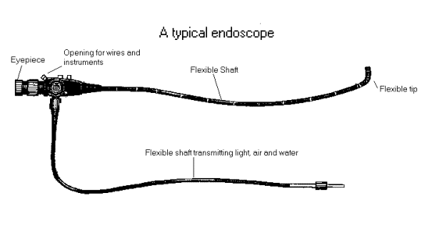
Endoscope
A camera that is on the end of a tube that be put into the body and be less evasive then regular surgery.
Tiny forceps can be attached to take small pieces of tissue for biopsy.

Slide 21
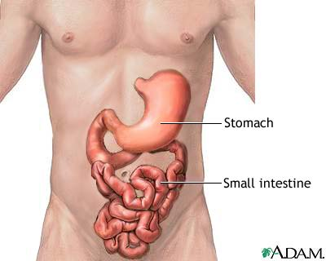

Slide 22
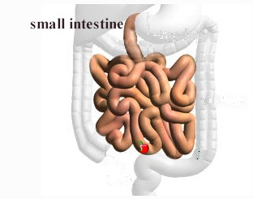
The Small Intestine and Pancreas
It is called the small intestine, because of its size in diameter compared to the large intestine.
It can measure up to 7-9 m in length and 2.5 cm in diameter.
The majority of digestion happens in the first 25-30 cm in the duodenum.
The three components of the small intestine are the duodenum, jejunum and the ileum.

Slide 23
Part where digestion is completed: nutrient macromolecules are finally broken down into their component molecules
Nutrients are absorbed into the circulatory system and carried to the rest of the body

Slide 24
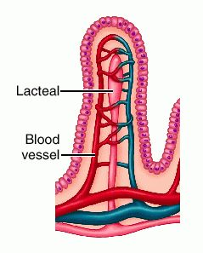
Villi
The small intestine is lined with small fingerlike tubes called villi which increases surface area.
Lacteal (a lymphatic capillary) that transports and absorbs materials like fats for later use.
Carbohydrates & Protein absorbed into blood stream

Slide 25
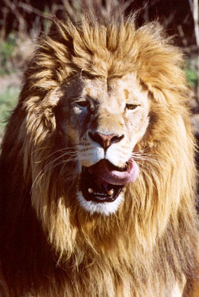
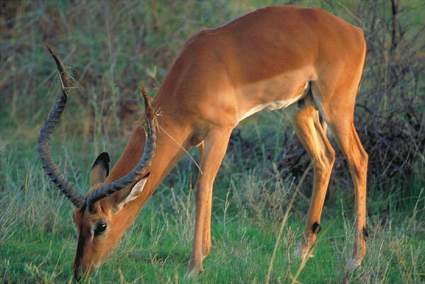
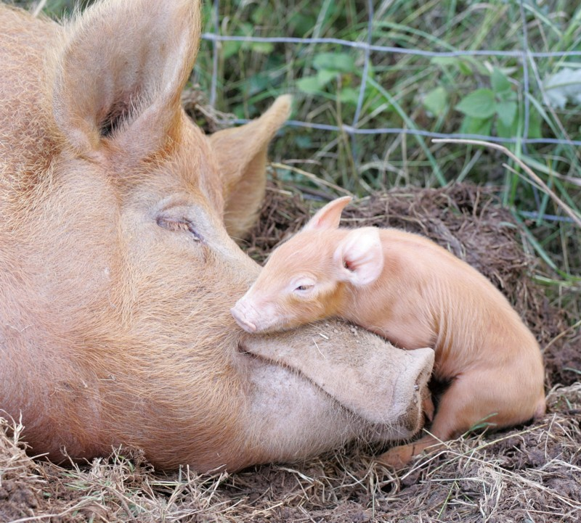
The Small Intestine and Pancreas
- length of the small intestine is dependent on the diet of the organism.
- Meats are easy to digest so a carnivore would have a short length.
Plants are relatively harder to digest, so an herbivore would have a longer length.
Omnivores, since they eat both plants and meats the length is somewhere in between.

Slide 26
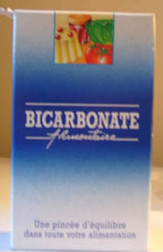
The Small Intestine and Pancreas
Chyme enters the intestine very acidic.
An enzyme named secretin alerts the pancreas to release the pancreatic and bile secretions.
Bicarbonate ions will help to neutralize the HCl.
This will change pH to 2.5-9.0. At this high pH the pepsin is inactivated.

Slide 27
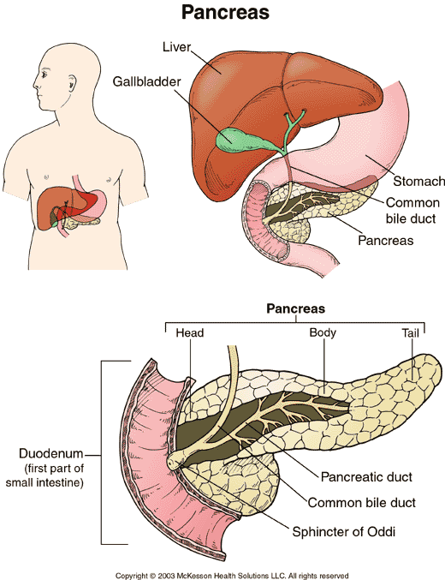

Slide 28
Production of digestive enzymes that act on foods in the small intestine;
Production of the hormone insulin and glucagon which regulates blood sugar levels;
The pancreatic fluid also contains enzymes that break down carbohydrates, proteins and lipids.

Slide 29
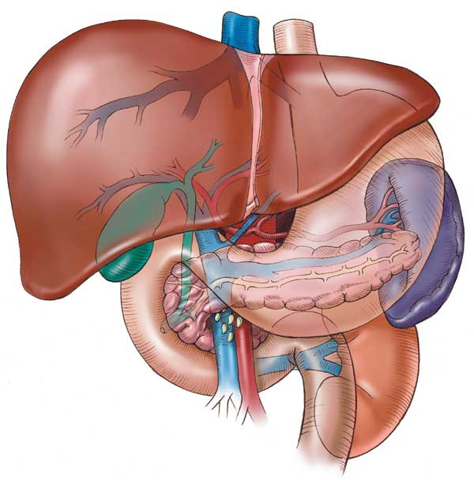
The Liver
& Gall Bladder

Slide 30
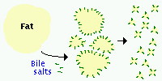
Liver and Gall Bladder
Largest organ in body – size of football (1.5 kg)
The liver produces bile that emulsifies fat. It is stored and concentrated in the Gall Bladder. When lipids enter small intestine CCK (cholecystokinin hormone) is released and it in turns activates the release of the bile salt. Emulsification of fats is a form of physical digestion that increases the surface area of fat molecules.

Slide 31
Clip: Demonstration how Bile emulsifies Fat using Dish Detergent and Oil
http://www.youtube.com/watch?v=VQrtYap84zA

Slide 32
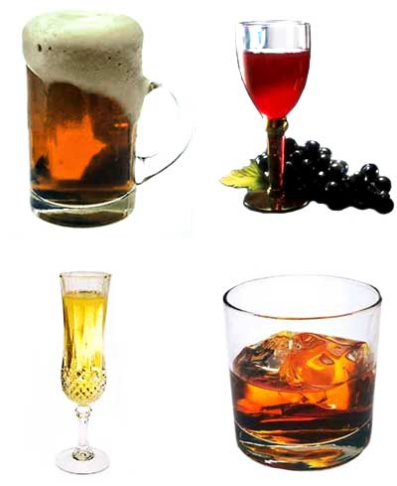
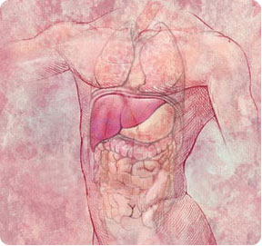
The liver has 4 functions:
Synthesis
Bile salts
Blood protein from amino acids
Breakdown/conversion
Removes nitrogen group from amino acids and forms urea (main part of urine)
Converts toxic part of haemoglobin, allowing it to be excreted with bile salts

Slide 33
The liver has 4 functions:
Storage, converts glucose to glycogen and vice versa
Detoxification, coverts harmful compounds, such as alcohol into less harmful products

Slide 34
Gall Bladder
Stores bile between meals

Slide 35
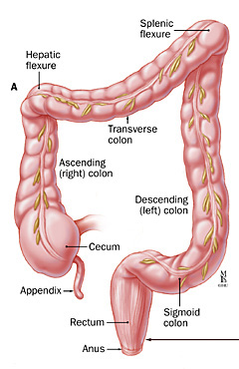
Large Intestine
Path through the Large Intestine
Ileoceal valve into cecum
Ascending colon
Transverse colon
Descending colon
Rectum
Anal Canal
Anus → defecation pushed out through contractions

Slide 36
Functions of Large Intestine
The colon stores the wastes long enough to reabsorb water (90% is reabsorbed) , inorganic salts, minerals, and vitamins.
Billions of anaerobic bacteria break down undigested matter further
Some bacteria produce important vitamins (folic acid, B and K) which are reabsorbed by the body

Slide 37
The leftover matter forms feces which are pushed into the rectum
Brown colour is due to bacterial breakdown of bilirubin (by-product of the breakdown of hemoglobin)
Odour comes from gases produced by bacterial activity

Slide 38
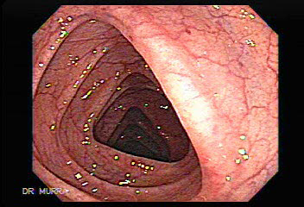
Colonoscopy
Colonoscopy is a procedure used to see inside the colon and rectum.
Colonoscopy can detect inflamed tissue, ulcers, and abnormal growths.
The procedure is used to look for early signs of colorectal cancer and can help doctors diagnose unexplained changes in bowel habits, abdominal pain, bleeding from the anus, and weight loss.

Slide 39
Timelines
Structure | Time
Mouth | 5-30 seconds
Esophagus | 10 seconds
Stomach | 2-24 hours
Small intestine | 3-4 hours
Large intestine | 18 hours – 2 days

Slide 40
Digestion in 1.5 min
http://www.youtube.com/watch?v=b20VRR9C37Q

Slide 41
Bozeman
http://www.youtube.com/watch?v=nM5kMSjBrmw

Slide 42
Substances involved in digestion
Organ | Enzymes and hormones | Function
mouth, salivary glands | Salivary amylase | Initiates the breakdown of polysaccharides to simple carbohydrates and dissacharides

Slide 43
Substances involved in digestion
stomach | Gastrin [h] HCl Pepsinogen [h] mucus rennin | Stimulates production of gastric juices Converts pepsinogen to pepsin; kills microbes When converted to pepsin, initiates the digestion of proteins Protects the stomach from pepsin and HCl Coagulates proteins in milk (children only)

Slide 44
Substances involved in digestion
pancreas, small intestine | Enterogasterone [h] Bicarbonate ion (HCO₃ ⁻) Trypsinogen Prosecretin | Provides negative feedback to slow down peristaltic movements allowing time for fat digestion Neutralize HCl from the stomach When activated to trypsin (by enterokinase), converts long chain peptides into short chain peptides (protein) When activated to secretin promotes release of (HCO₃ ⁻) from pancreas

Slide 45
Substances involved in digestion
pancreas, small intestine | Lipase Erepsin Disaccharidases (eg. maltase) pancreatic amylase Cholecystokinin [h] (CCK) | Breaks down fats to glycerol and fatty acids Completes the breakdown of proteins into amino acids Breakdown disaccharides into monosaccharides (sugars) Promotes release of bile.

Slide 46
Substances involved in digestion
liver | Bile | Emulsifies fat
gall bladder |  | Stores concentrated bile from the liver
large intestine | Mucus | Helps movement of food; stores wastes; absorbs water; produces vitamin K and B₁₂ by bacteria

